Slide 1
Blood Bank Management System using AWS
School of Computer Science and Engineering

Slide 2
Team no. AWS 43
Guide Name: Prof. Suhasini N
Team Members:
Misbah Anjum N
Manas Patil
Samartha S R
K K Reethika
R19CS189
R19CS179
R19CS470
R19CS152

Slide 3
agenda
ABSTRACT
INTRODUCTION
PROBLEM STATEMENT
OBJECTIVES
LITERATURE SURVEY
METHODOLOGY
MODULES EXPLANATION
SAMPLE CODE AND SCREENSHOT OF THE OUTPUT
CONCLUSION
REFERENCES

Slide 4
ABSTRACT
The Blood Bank Management System is an application that stores, processes, retrieves, and analyzes data about blood bank administration
The purpose of this technology is to develop a blood management information system to monitor real time management of blood donor records and control the distribution of blood in various parts of the country based on the requirements.
This technology helps people who are in need of blood to keep track of donors, blood groups, blood banks, and stock information. It keeps track of all information concerning blood. Without the use of this technology it would be very different to access blood records which would put someone's life in danger.

Slide 5
introduction
The project blood bank management system is known to be a pilot project that is designed for the blood bank to gather blood from various sources and distribute it to the needy people who have high requirements for it.
The project is an online system that allows to check weather required blood deposits of a particular group are available in the blood bank.
Moreover the system also has added features such as patient name and contacts, blood booking and even need for certain blood group is posted on the website to find available donors for a blood emergency.
It also helps to register the details of donors as well as blood collection details .

Slide 6
Introduction : domain
DOMAIN : Amazon Web Services (AWS)
Amazon web service is an online platform that provides scalable and cost-effective cloud computing solutions.

Slide 7
Introduction : Front end details
HTML: All the basic web pages are written with Hypertext Markup language in which other scripts in different languages can be easily added to the HTML code.
CSS: Style Sheet language is added to the HTML to add better user effects while surfing the site, betterment of colors, sizes, and padding, and finally build a brand presence among users.

Slide 8
Introduction : back end details
PYTHON : It is a high-level, interpreted programming language. We make use of python flask library to dynamically move from one web page to another and perform other backend functions such as checking on user credentials, sending details to the online database, and retrieving information from it.
SQLite: For storing the data in structured formats, we make use of the SQLite database engine written in the C language. SQLite is a more rigid structure and it is not a standalone application that software developers can embed apps.
JAVASCRIPT: It is used along with the structures of HTML and CSS code on the client end to check on web page behaviour and integrate third-party libraries as well.

Slide 9
Introduction : back end details
AWS EC2: Amazon Elastic Compute Cloud is a part of Amazon’s cloud computing platform which provides secure, resizable compute capacity in the cloud. It is designed to make web- scale cloud computing easier for developers.
AWS BEANSTALK: AWS Elastic Beanstalk is a hosting service that assists in deploying applications and orchestrates various services. We simply upload our code and Elastic Beanstalk automatically handles the deployment, auto- scaling to application health monitoring.

Slide 10
Exsisting system
The operation of the blood bank still now is maintained in the manual system.
The operation is tedious, time consuming and space consuming.
It creates room for errors as the data is entered manually by the persons.
It includes the risk of the documents being lost over years and maintenance of the records is difficult.
The data recorded during testing or while acquiring the details of different aspects of blood bank management system is not so accurate and precise.

Slide 11
problem statement
Scarcity of rare blood group.
Unavailability of blood during emergency.
Less awareness among people about blood donation .
Deaths due to lack of blood during operations.
The Blood Bank Management System project aims to make all the procedures automated and therefore with computer system it can be more fast and accurate.

Slide 12
objectives
This web-based application provides:
To check the availability of blood bags anytime.
To manage the information of its blood donor.
To allow good documentation about the donor and its blood donation activities.
Support fast searching to find match blood bags for the right person

Slide 13
Literature survey
A. Enhancing Blood Transfusion Safety Through the Use of Online Blood Bank Management System in Oman (2018)
This study concluded that online blood bank management system is much better than the manual system. The findings showed that respondents prefer to use online blood bank management system rather than the manual system.[1]
B. Development of a Blood Bank Management System by Procedia (2015)
This study made sure that the management of the blood stock became effective, systematic and meeting user requirements. The functional services provided in the current version are profile management, blood stock management, and blood analysis management. [2]

Slide 14
Literature survey
C. Online Blood bank Management System by IRJET (2021)
This report focuses on the advancement in technology which is the prime reason that Most of the facilities are available easily and quickly in generally all the sectors of life. Similarly, our proposed system is a major advancement in the management of blood which is intended to increase efficiency in the collecting and procuring blood. [3]
D. Blood Bank Management System by Galgotias University
According to this project, Blood Bank Management System is very essential for the different kinds of people including doctors, nurses, engineers, laborers, managers and all kinds of staff in hospital to facilitate updated information about donor and recipients. [4]

Slide 15
methodology
Approach for design:
To approach this research, we utilize two ways. In the initial stage, we selected a number of research papers on this specific field (blood bank management system). All the selected papers are peer-reviewed. We then proceeded to extract significant information necessary for our research. Further on, we tried to acquire some of the forms used in collecting information from donors with the help of surveys.

Slide 16
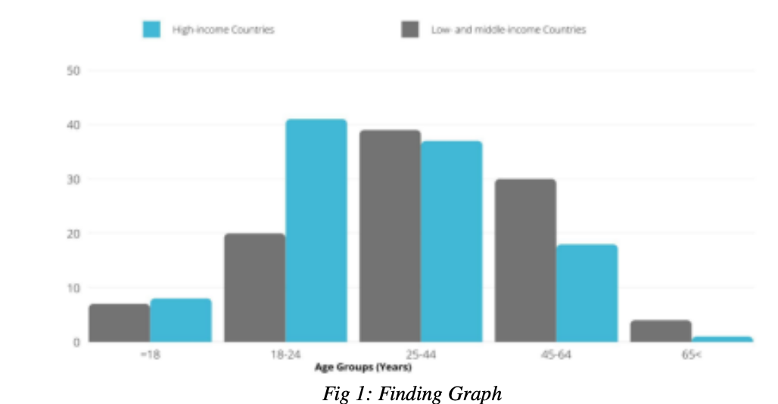
methodology

Slide 17
methodology
Findings:
Data about the gender profile of the blood donors show that globally 30% of blood donations are by women although the findings differ from place to place. To support the statement, out of 20 of the 111 reporting countries, less than 10% of donations are by female donors. Regarding the age profile of donors, it shows more young people from low and middle-income countries donate blood. We rely on findings for demographic information of the blood donors as it is important to formulate and monitor recruitment strategies.

Slide 18
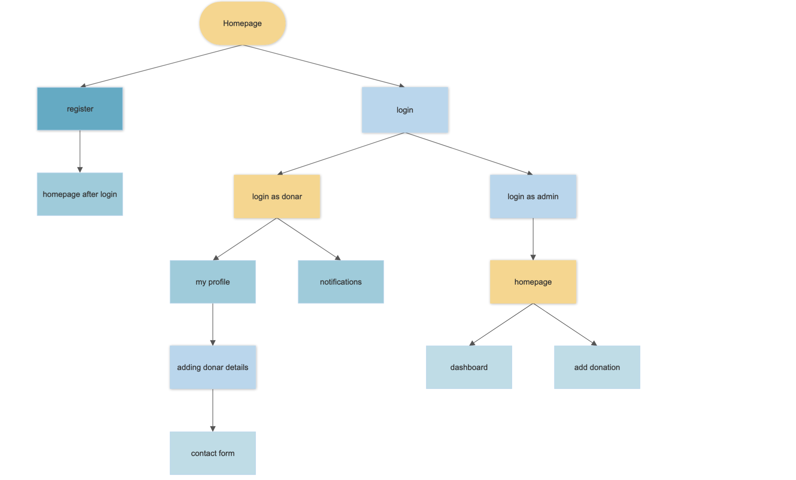
Modules involved

Slide 19
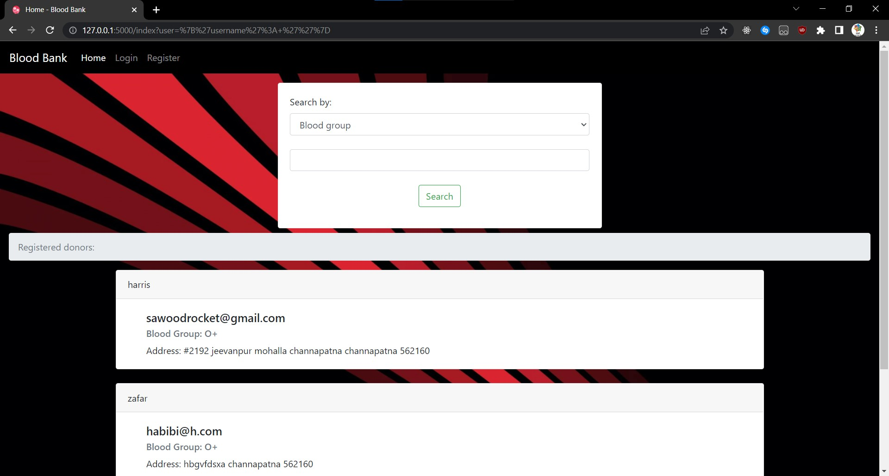
Modules explaination
Homepage : Landing page the user of the website visits once the site is opened. The user can log in, register, or search for required blood type availability.

Slide 20
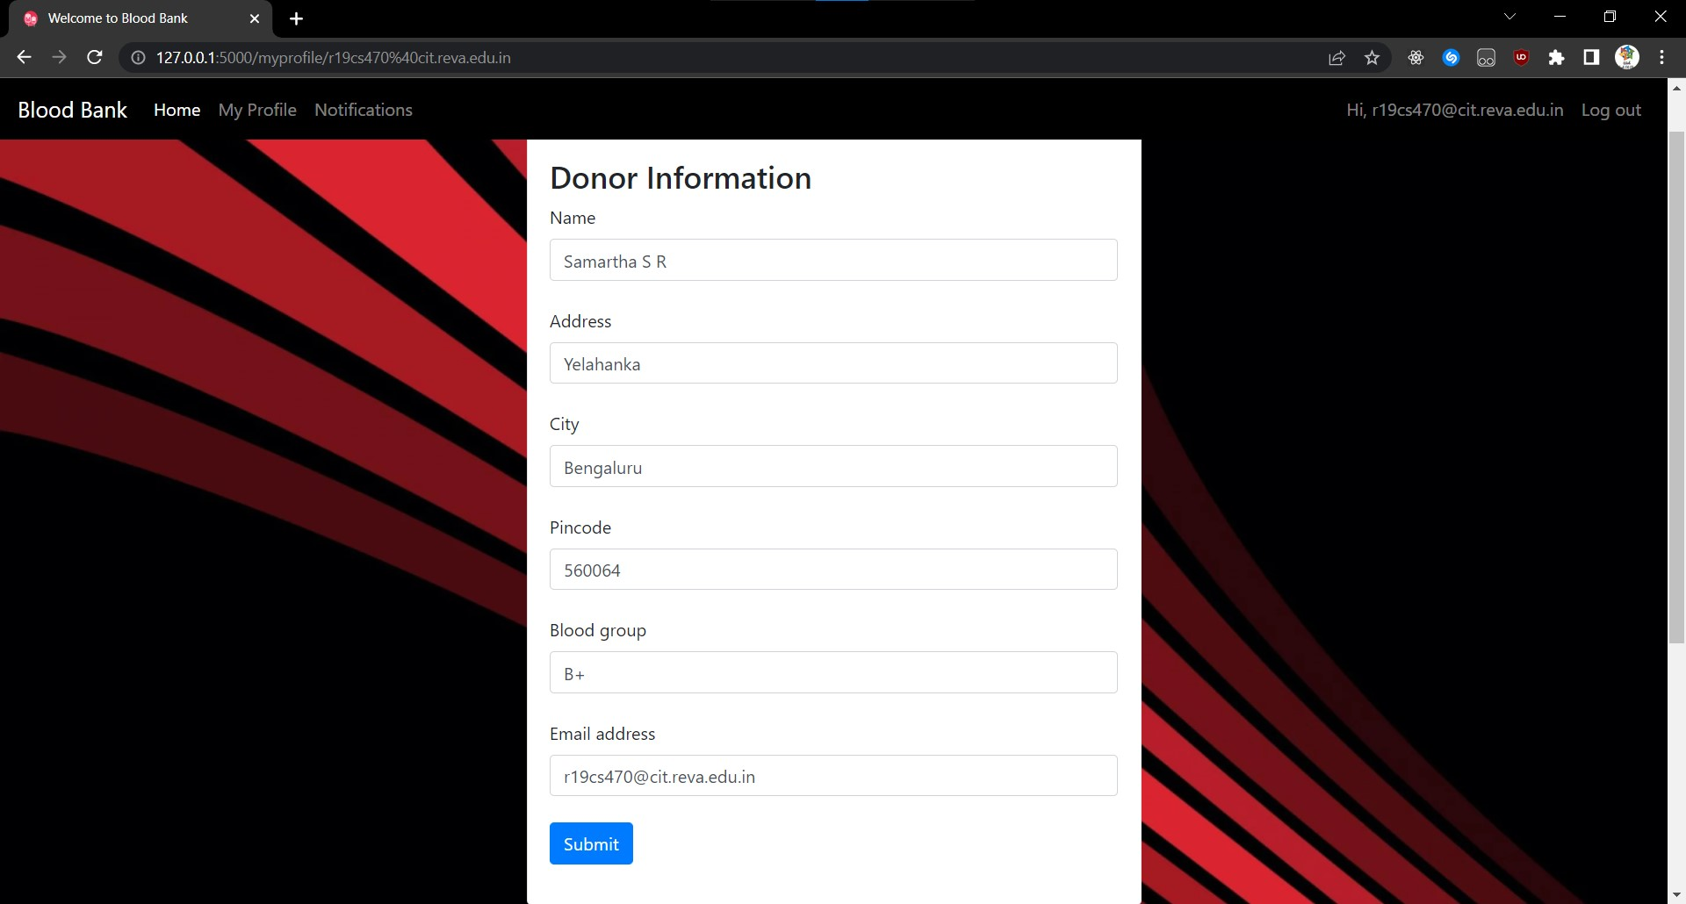
Modules explaination
Register : When a new user enters the site for the first time, a new account can be registered from the Register page with some mandatory user credentials.

Slide 21
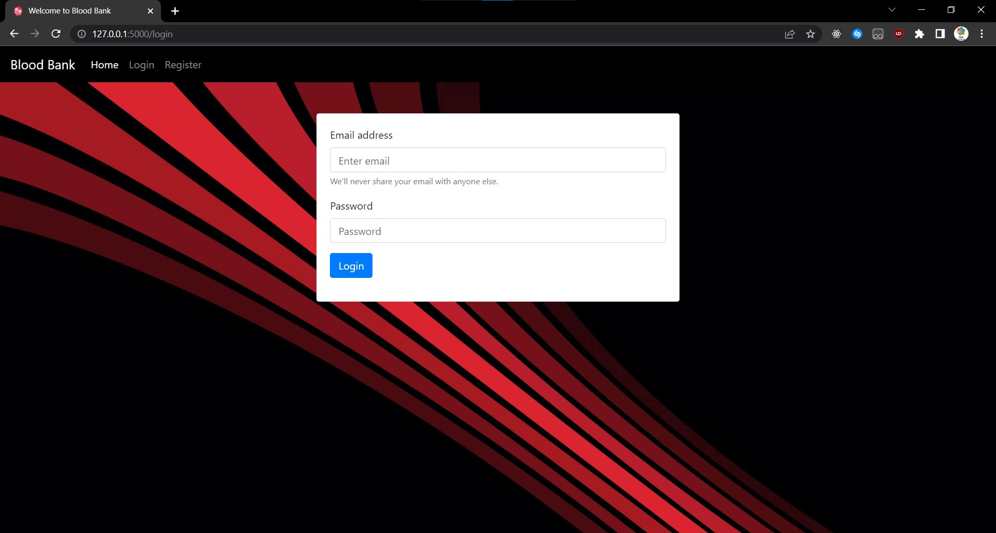
Modules explaination
Login : The user should log in to the application to make use of the blood bank management system.

Slide 22
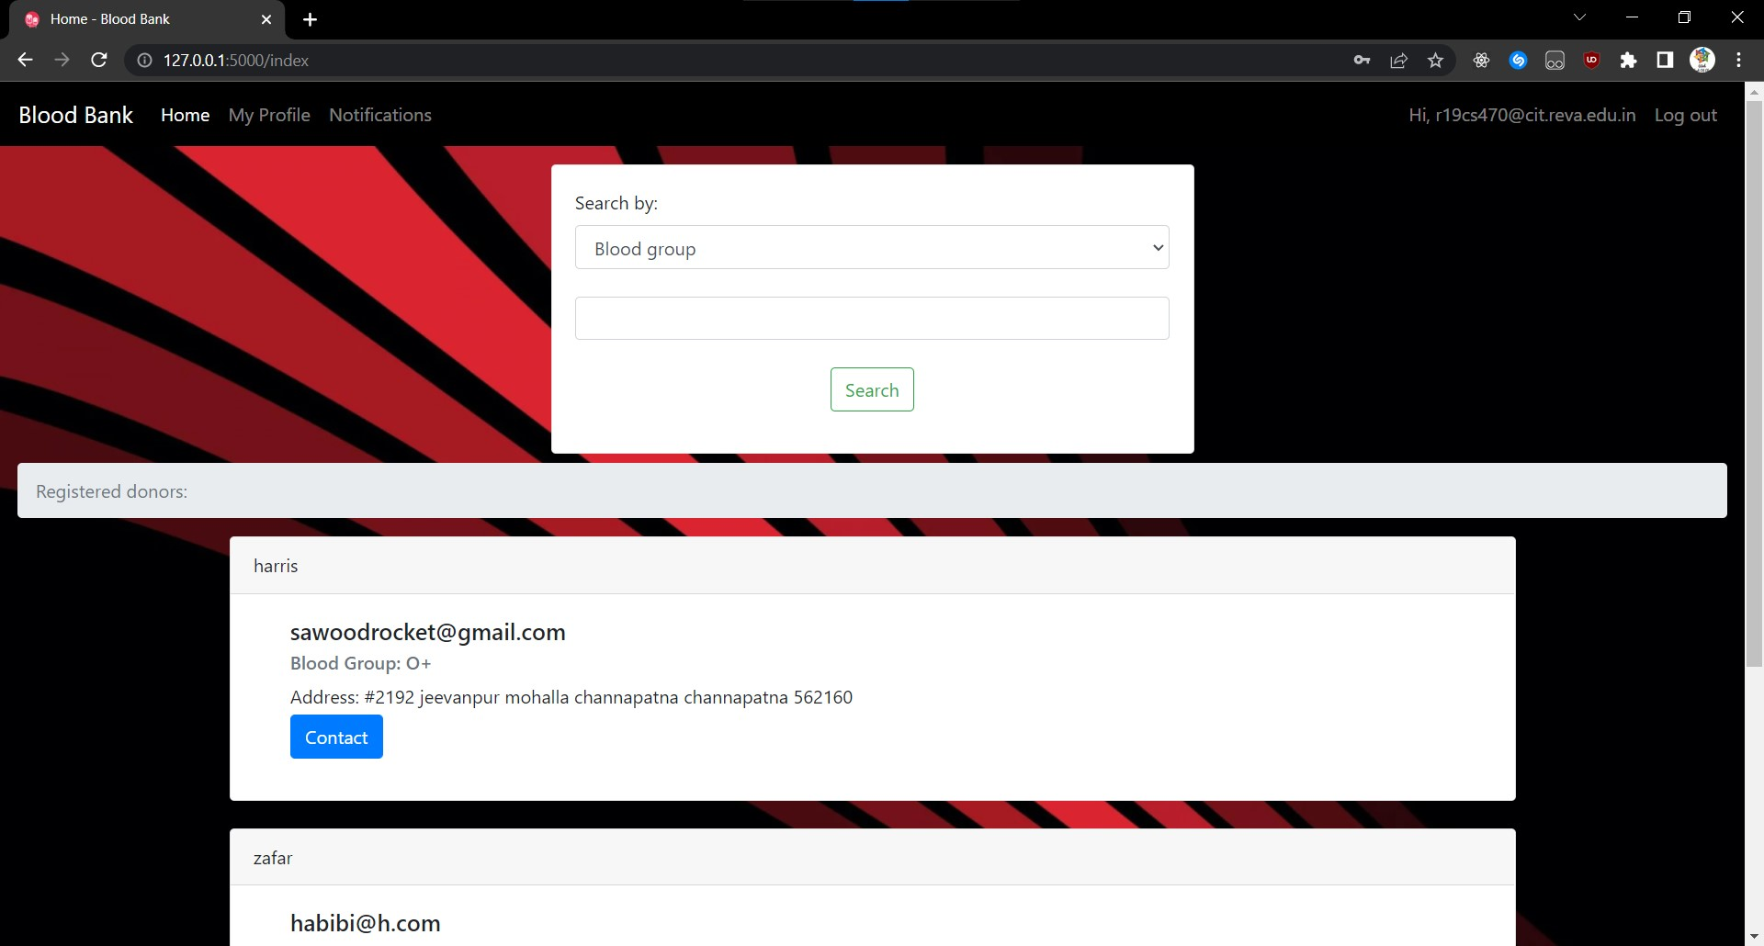
Modules explaination
Homepage after Login : After logging in, the user is directed back to the homepage, with a menu called Profile where the user can add their details.

Slide 23
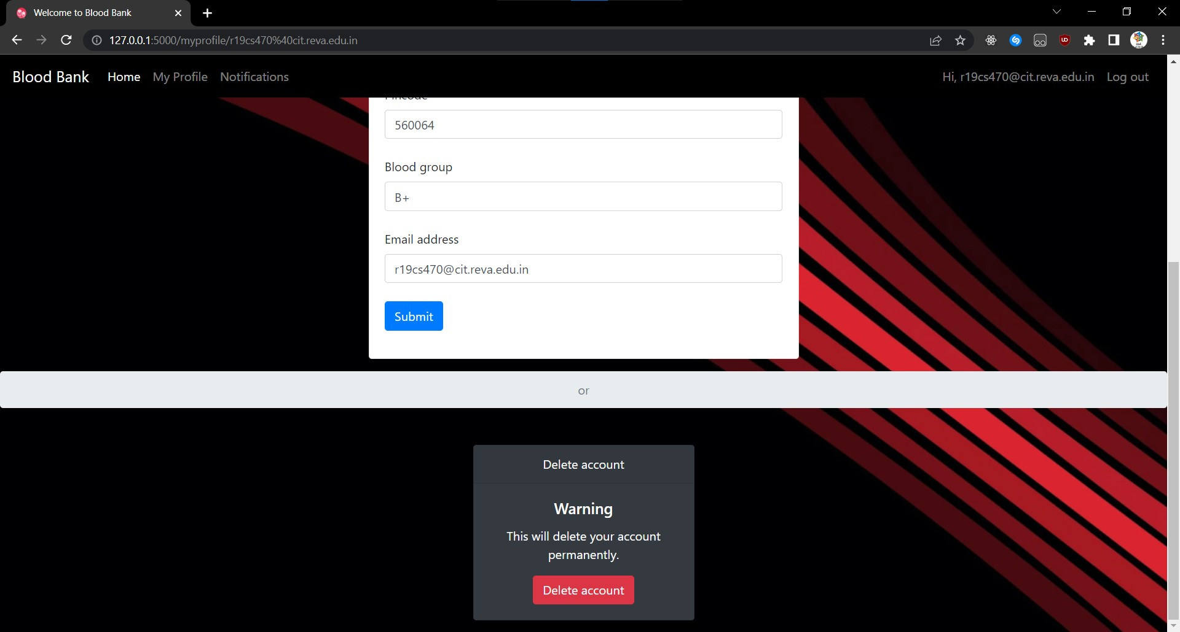
Modules explaination
Adding Donor Details : For the donor registration, you will fill out the forms. This information is required to log in and out of the user account. To complete your registrations, some details needed are the name, gender, date of birth, blood type, phone number,email address, and home address.

Slide 24
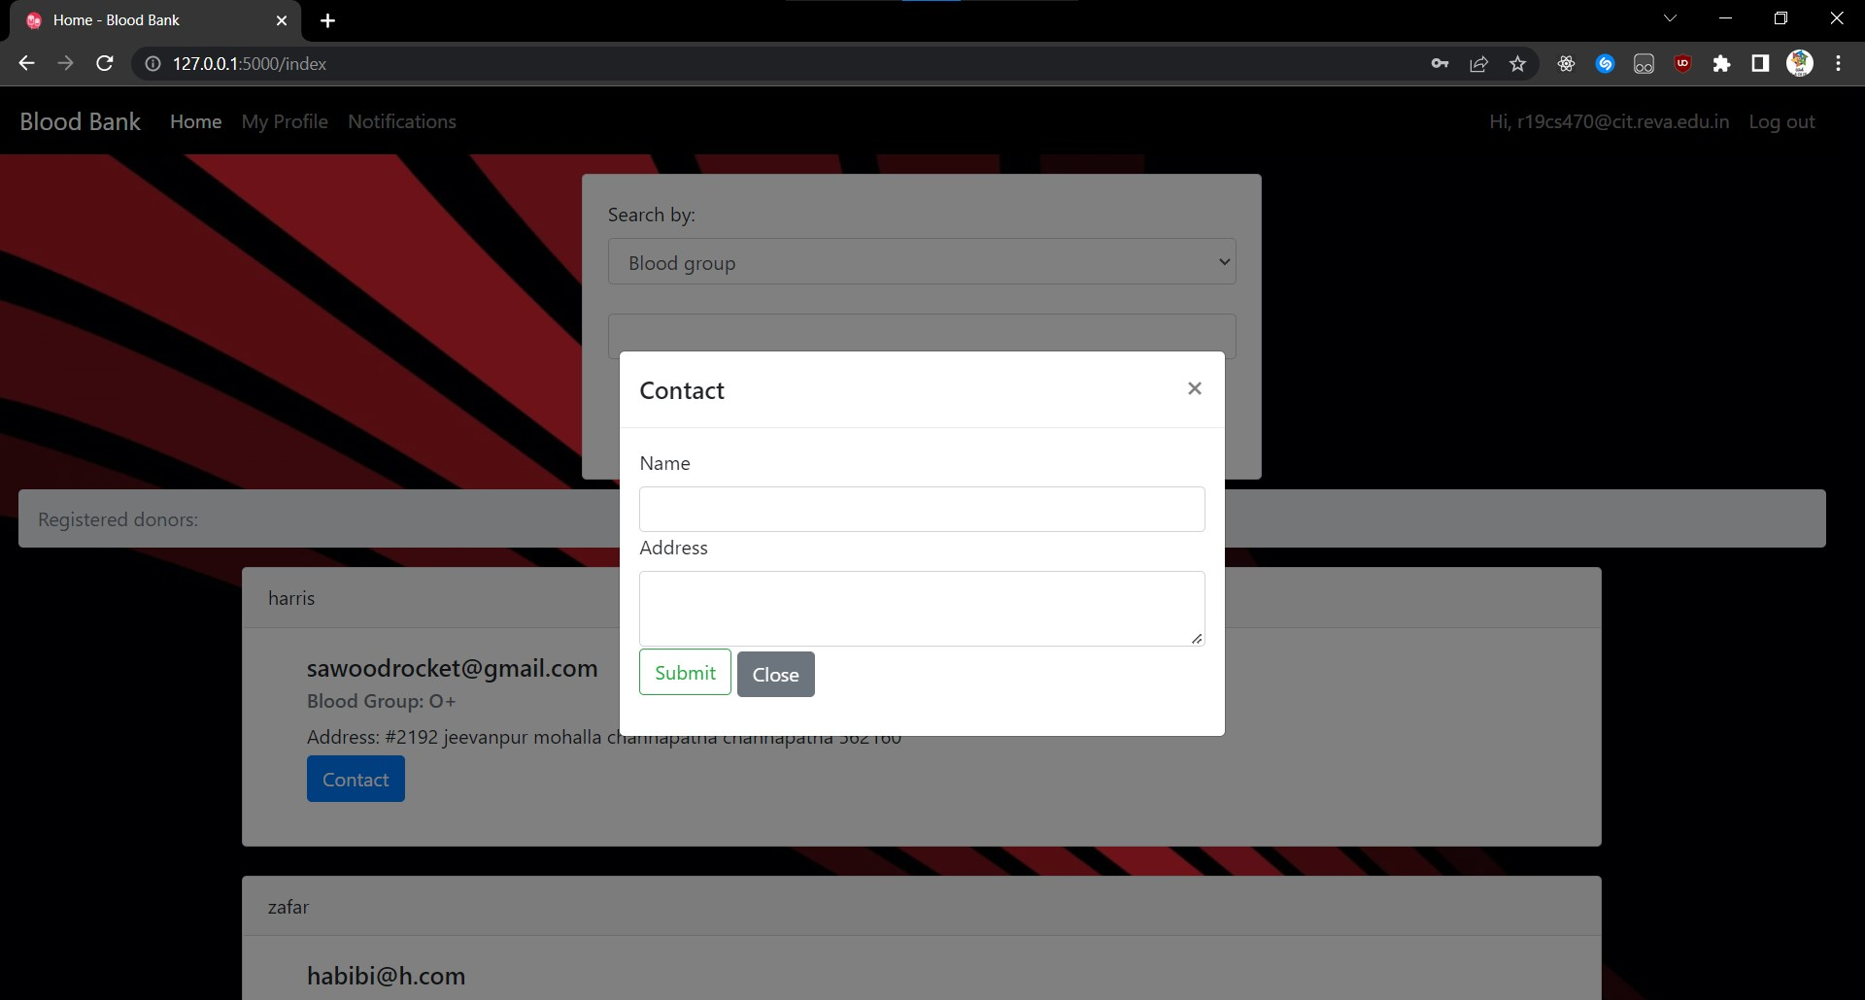
Modules explaination
Contact Form : The user has ease of accessibility for contacting their required blood group donor by tapping on the blood donor contact details.

Slide 25
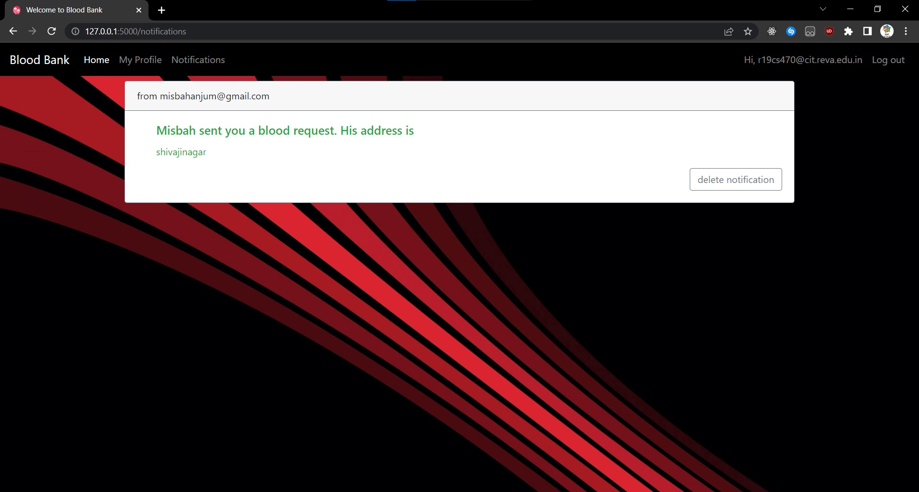
Modules explaination
Notification: A notification will be sent to the donor which is visible when he logs into the website through which he is notified that a person is in need of blood.

Slide 26
Modules explaination : ADMIN CREDENTIALS admin@bloodbank.com
Homepage:
With the admin’s credentials, the admin user accesses management controls instead of the user dashboard and has admin privileges.
Dashboard:
The admin dashboard views all the blood types collected by the hospital along with pint quantity and also the total amount of pints.

Slide 27
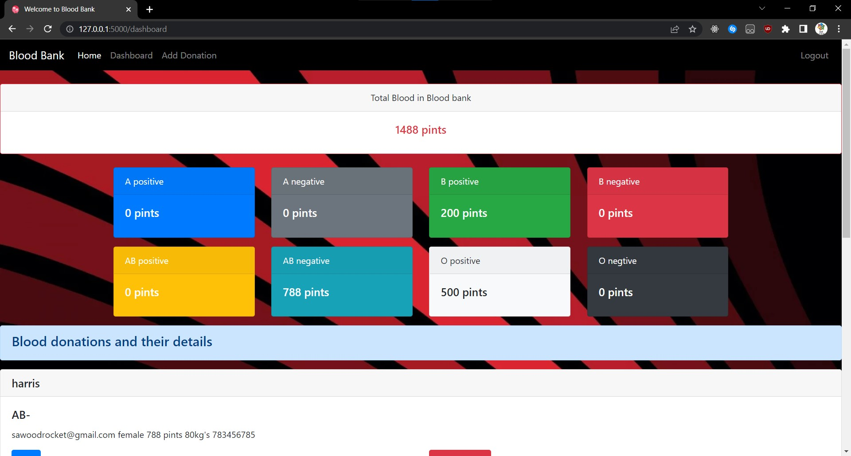
Modules explaination : ADMIN CREDENTIALS

Slide 28
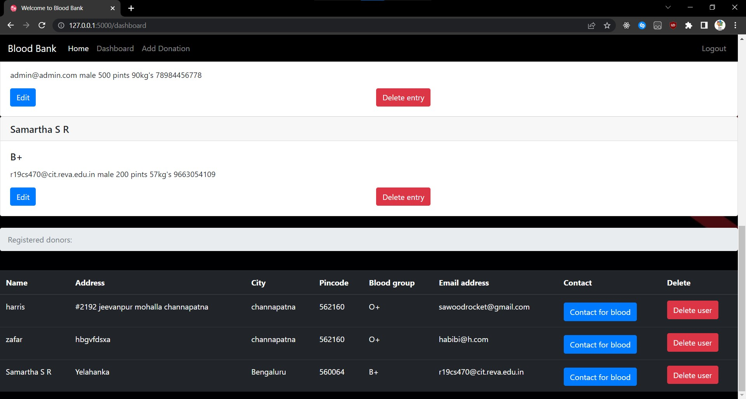
Modules explaination : ADMIN CREDENTIALS

Slide 29
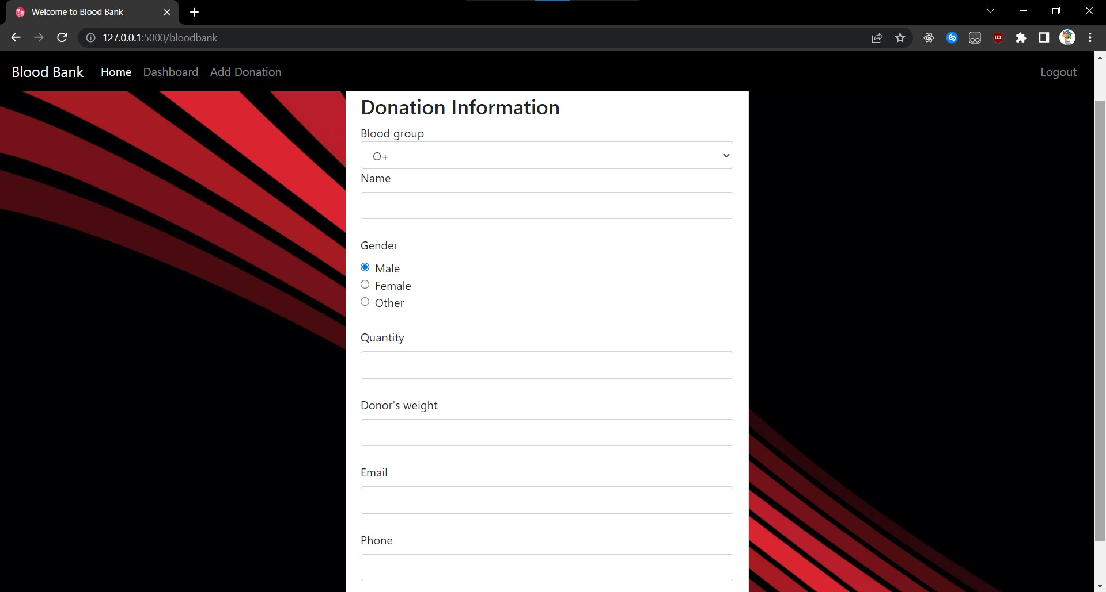
Modules explaination : ADMIN CREDENTIALS
Add Donation: With this feature, the admin exercises privileges to verify, edit and add the donor details and contact information to the updated donor listing.

Slide 30
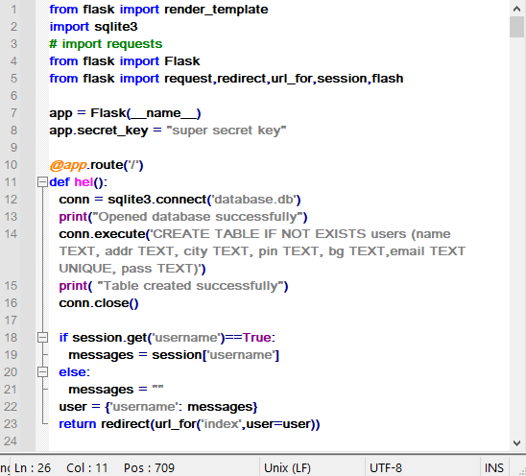
Sample code

Slide 31
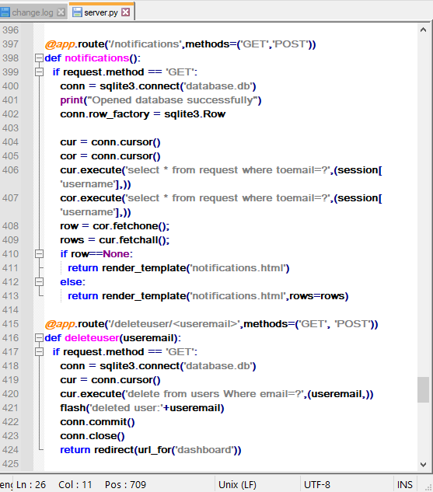
Sample code

Slide 32
conclusion
The Blood Bank Management System addresses the needs of every issue that is associated with blood. The issues could include difficulty in tracing their donors, managing blood bank accounts, and addressing the efficiency of doing transactions in Hospitals.
The proposed Blood Bank website helps the people who are in need of blood by giving them all details of blood group availability or regarding the donors with the same blood group. They don’t need to go anywhere to search the blood when they need. They just need to use this software then all the result will appear in just a second.Our life is so busy so we don’t have time to spend going here and there, we can use technical way to search the blood by using the Blood Bank software we can find thousands of people who are donating the blood and also get the details of the doner and the city he belongs to and what is their Blood group.
This is how the software could be used efficiently and help people who are in need.

Slide 33
reference
[1] Nawaf Hamed Al-Washahi, Alsafa Ahmed Aal-abdulsalam, and Afrah Sulaiman Al-Mamari, Eds., “Enhancing Blood Transfusion Safety Through the Use of Online Blood Bank Management System in Oman,” Dec. 2018.
[2] Sumazly Sulaiman, Abdul Aziz K.Abdul Hamid, and Nurul Ain Najihah Yusri, Eds., “Development of a Blood Bank Management System by Procedia,” 2015.
[3] Chetan Masram, Arshad Mulani, Rasika Bhitale, and Jidnesh Koli, Eds., “Online Blood bank Management System by IRJET,” 2021.
[4] Amar Ahsan, Avi Srivastva, and Vibhav Pandey, Eds., “Blood Bank Management System by Galgotias University.”

Slide 34
THANK YOU

